Slide 1



STRATEGIC PLANNING FOR
INNOVATION AT SNOWFLAKE
IST 755 Capstone Final Presentation
Tejal Palwankar, Priya Vora
© 2021 Snowflake Inc. All Rights Reserved

Slide 2
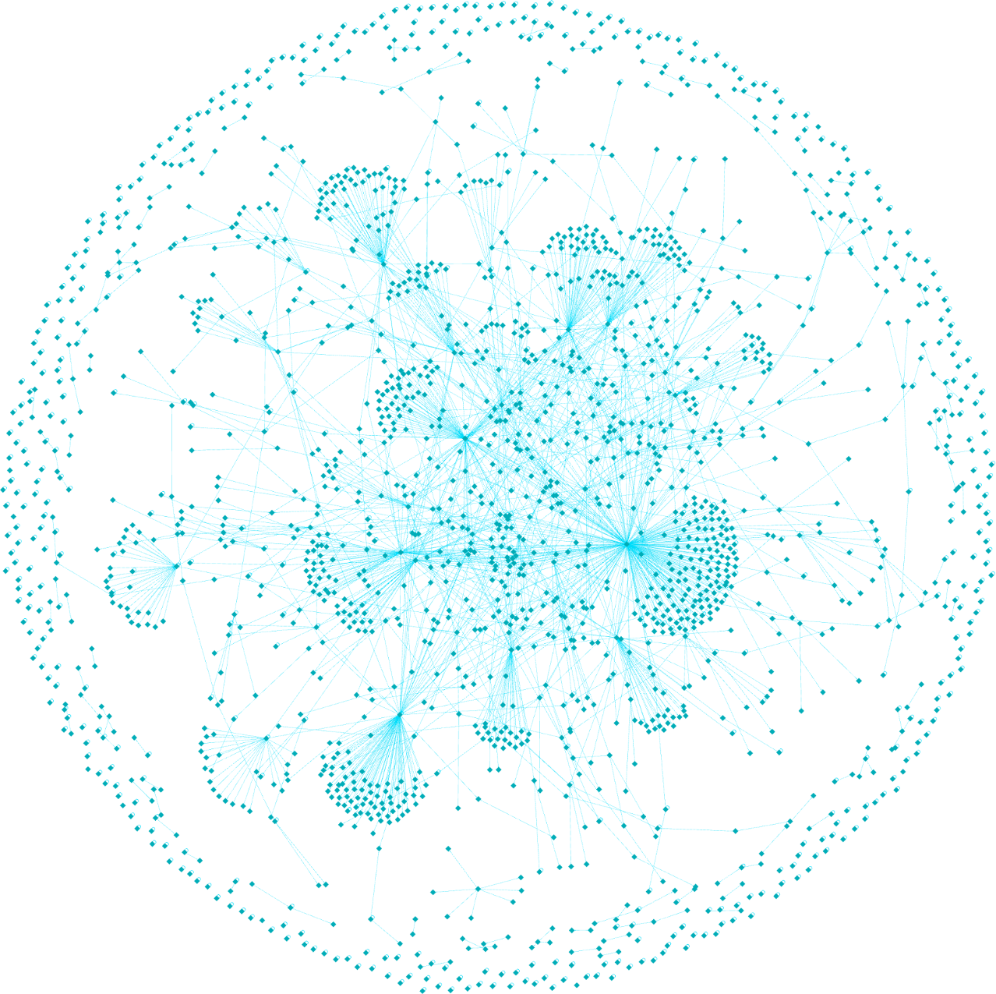
Meet Snowflake: The Cloud Data Company
Company Snapshot
📍 Founded 2012 | Bozeman, Montana
🌎 6,000+ global customers
⚡ 1.6T queries processed daily
Real-Time Data Analytics:
Low-latency insights via streaming pipelines and optimized workloads.
Cloud-based data platform for
☁️ Storage
⚙️Compute
📊 Analytics
AI/ML Platform Expansion
Support model training & deployment directly in-platform via seamless ML integrations.
Decentralized Data Marketplace:
Build a blockchain-powered data exchange for secure, compliant data monetization.
Why It Stands Out 🔁 Multi-cloud operations (AWS, Azure, GCP) 🔐 Secure, zero-copy data sharing ⚡ Fast, scalable & user-friendly platform
AI Copilot Integration
Introduce a conversational AI assistant to guide users through querying and analysis.
“Snowflake’s architecture and ecosystem make it an ideal candidate for innovation through real-time analytics, AI/ML integration, and decentralized data sharing.”
* Visualization based on actual Data Cloud sharing activity as of July 31 2021

Slide 3






Strategic Planning Canvas: Framework for Innovation
SENSE
SEIZE
TRANSFORM
Tech Signals
(Blockchain,
AI/ML)
AI/ML
Platform
Real-Time
Analytics
Build
Partnerships
Mobilize
Talent
Market
Trends
Customer
Demands
Develop
Prototypes
Decentralized
Marketplace
This framework enables Snowflake to continuously evolve in a fast-moving data economy — from sensing change to delivering transformation.

Slide 4





Opportunity 1: Improve Real-Time Analytics
GAP
Limited support for real-time analytics restricts Snowflake’s use in latency-critical sectors like finance and security.
STREAMING INGESTION
LOW-LATENCY QUERY ENGINE
LIVE DASHBOARDS & ALERTS
Integrate Kafka and Snowpipe to enable sub-second ingestion of high-frequency data from diverse sources.
Optimize query execution with adaptive caching and in-memory processing for real-time analytics at scale.
Develop real-time visualization and automated anomaly alerts to support operations, fraud teams, and trading systems.
Opportunity
Add real-time data ingestion, low-latency queries, and live dashboards to unlock new, high-speed use cases.
© 2021 Snowflake Inc. All Rights Reserved

Slide 5
Powering Speed at Scale
01
Form a Real time Ops Team
Launch a real-time engineering taskforce focused on stream ingestion and low-latency performance.
02
Pilot with High-Frequency Industries
Collaborate with financial and cybersecurity partners to test and refine real-time features.
03
Develop Toolkits & Templates
Create best practices, dashboard templates, and alert logic for fast deployment by clients.
04
Launch Enablement Programs
Train customer success teams and provide onboarding materials to drive adoption.

Slide 6



Opportunity 2: Transform with AI/ML Platform Expansion
GAP
Snowflake lacks in-platform support for building, training, and deploying machine learning models.
Integrate ML Frameworks
In-Platform Training
Partner & Upskill
Use smart contracts for usage rights, access control, and data licensing — reducing manual contract friction.
Implement zero-knowledge proofs, data masking, and consent-based sharing to align with GDPR, HIPAA, etc.
Allow pricing models (subscription, per-use), token-based access, and vendor discovery for broader data economy participation.
Opportunity
Transform Snowflake into a unified AI/ML platform by embedding model lifecycle capabilities and ML framework integrations.
© 2021 Snowflake Inc. All Rights Reserved

Slide 7
Embedding Intelligence into the Platform
01
Create an AI/ML Integration Team
Task internal experts with developing APIs and infrastructure for ML workflows.
02
Launch Joint Pilots with Key Clients
Partner with early adopters to test model training, deployment, and feedback loops.
03
Build a Snowflake ML Toolkit
Package reusable components, sample notebooks, and best practices for in-platform ML.
04
Roll Out Internal & External Training
Launch a certification program and AI skill-building tracks for clients and staff.

Slide 8
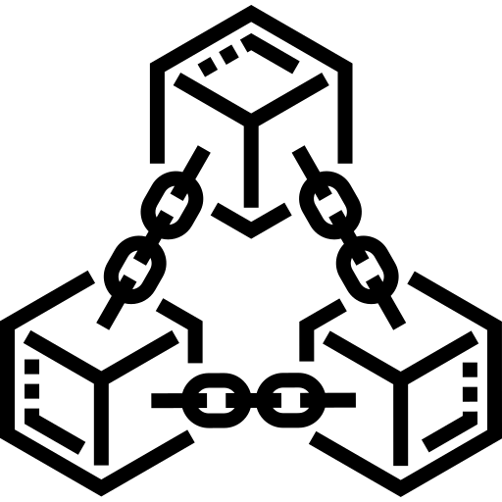


Opportunity 3: Innovate with Decentralized Marketplace
GAP
Snowflake’s current data sharing is centralized and lacks monetization controls, trust layers, or decentralized access.
Blockchain Integration
Privacy & Compliance
Monetization & Ecosystem
Use smart contracts for usage rights, access control, and data licensing — reducing manual contract friction.
Implement zero-knowledge proofs, data masking, and consent-based sharing to align with GDPR, HIPAA, etc.
Allow pricing models (subscription, per-use), token-based access, and vendor discovery for broader data economy participation.
Opportunity
Build a blockchain-based data marketplace to enable secure, transparent, and compliant data exchange
© 2021 Snowflake Inc. All Rights Reserved

Slide 9
Building Trust Through Secure Exchange
01
Assemble a Web3 Taskforce
Form a cross-functional team to lead blockchain strategy, development, and compliance.
02
Run Private Marketplace Pilots
Test data tokenization and access controls with select providers and buyers.
03
Design User Experience & Monetization Model
Develop an intuitive marketplace UI and define pricing models (tokenized, subscription).
04
Engage Legal & Compliance Partners
Work with regulators and legal teams to ensure alignment with data privacy laws (GDPR, HIPAA).

Slide 10

Building Trust Through Secure Exchange
Real-Time Analytics
Unlocks latency-critical use cases in finance, fraud, and cybersecurity through faster insights and proactive alerting.
Snowflake’s evolution from a cloud data warehouse to a real-time, intelligent, and decentralized platform ensures long-term competitive advantage and industry leadership.
AI/ML Integration
Turns Snowflake into a predictive analytics engine with in-platform model development, boosting decision-making at scale.
Decentralized Marketplace
Builds trust and monetization through secure, blockchain-based data exchange — enabling a transparent data economy.

Slide 11
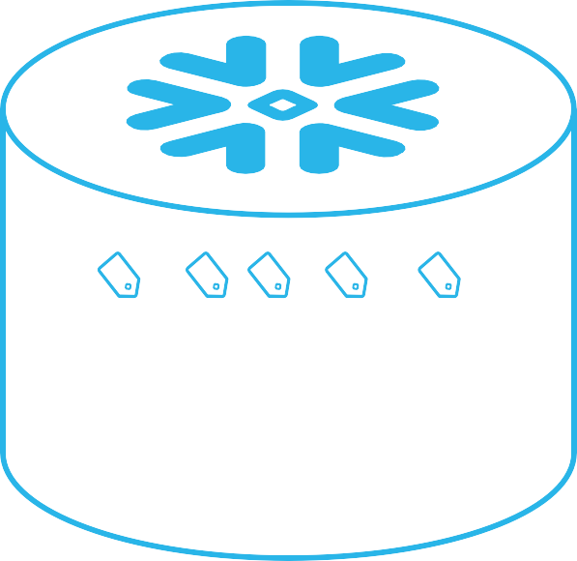

Major Risks & Management Methods
Data Privacy & Compliance Risk
Mitigation Tactics:
Snowflake handles sensitive data for clients in healthcare, finance, etc.
Expansion into real-time analytics and data marketplace increases exposure to privacy laws (e.g., GDPR, HIPAA, CCPA).
Non-compliance could result in heavy fines, lawsuits, and reputation damage.
Auto privacy checks before sharing
Strict access controls & data masking
Built-in compliance (GDPR, SOC 2, HIPAA)
External audits & compliance reviews

Slide 12

Major Risks & Management Methods
Talent Shortage for Real-Time & AI/ML Capabilities
Mitigation Tactics:
Advanced product changes (AI integration, real-time processing) require highly specialized engineers and data scientists.
Global talent shortage makes recruitment difficult and expensive.
Launch internal training programs and certifications for real-time analytics and AI/ML tools.
Offer competitive compensation, remote-first roles, and career development paths to attract talent.
Partner with universities and bootcamps to create long-term pipelines.

Slide 13

Major Risks & Management Methods
Cloud Provider Dependency Risk
Mitigation Tactics:
Snowflake depends heavily on third-party cloud infrastructure (AWS, Azure, GCP).
Service outages, price hikes, or policy changes directly affect performance and margins.
Diversify operations across multiple cloud providers to ensure redundancy.
Build in-house abstraction layers for cloud-agnostic deployment.
Negotiate long-term contracts with SLA guarantees and price stability.

Slide 14
Strategic Planning Timeline

Slide 15

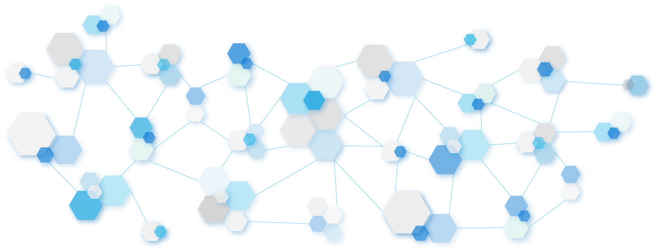
3 PHASE CYCLE
12-month roadmap for innovation rollout: from planning to pilot to platform launch
Phase 2 –
Pilot & Testing (3–6 Months)
Validate
functionality and gather user feedback
Phase 1 –
Setup & Planning (0–3 Months)
Define scope, align teams, finalize tech stack
Phase 3 –
Copilot & Marketplace Launch (6–12 Months)
Launch core features and begin scaling strategy

Slide 16
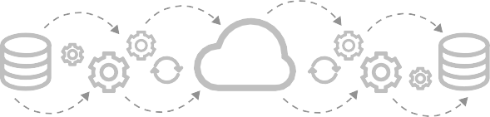
Phase 1
Phase 2
Setup & Planning
(0–3 Months)
Pilot & Testing
(3–6 Months)
Form cross-functional teams across product, engineering, and compliance.
Launch pilot versions of:
Real-time analytics features
Finalize infrastructure roadmap for real-time upgrades.
AI/ML integration with partner platforms like Hugging Face.
Define KPIs and identify pilot clients for AI/real-time features.
Collect performance data and customer feedback.

Slide 17
Phase 3
Ongoing
Marketplace & Copilot Launch (6–12 Months)
Continuous Improvement & Scaling (Post 12 Months)
Deploy MVP of decentralized data marketplace to select enterprise users.
Expand features across all user tiers.
Introduce Copilot AI assistant within the UI to assist with query generation and data navigation.
Use in-platform feedback and analytics to improve performance.
Onboard initial partners (data sellers/buyers) to test smart contract licensing.
Regularly release updates and improvements to AI, marketplace, and real-time modules.

Slide 18
Q & A
© 2020 Snowflake Inc. All Rights Reserved

Slide 19

THANK YOU
© 2021 Snowflake Inc. All Rights Reserved

